Slide 1
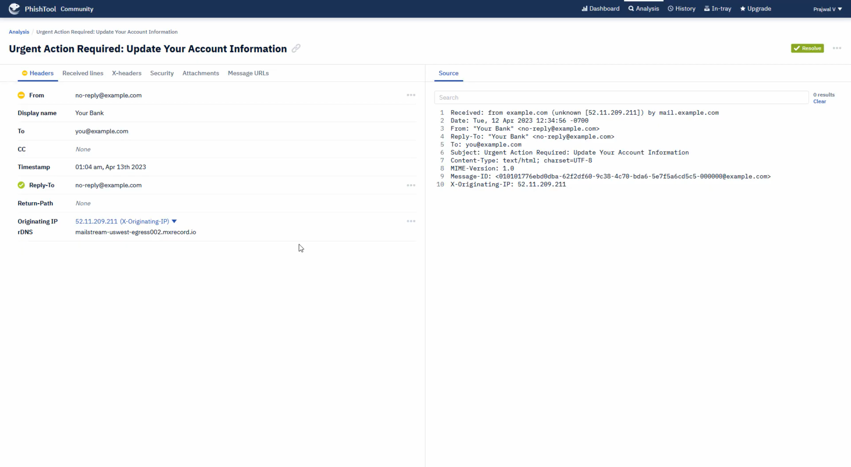
TASK-2 Analyze a Phishing Email Sample
Tools Used : Gmail, PhishTool.
Phishing Indicators Found : Sender Address, Header Issues, Links in Email, Language/Tone, Grammar Errors, Attachment, Branding.

Slide 2
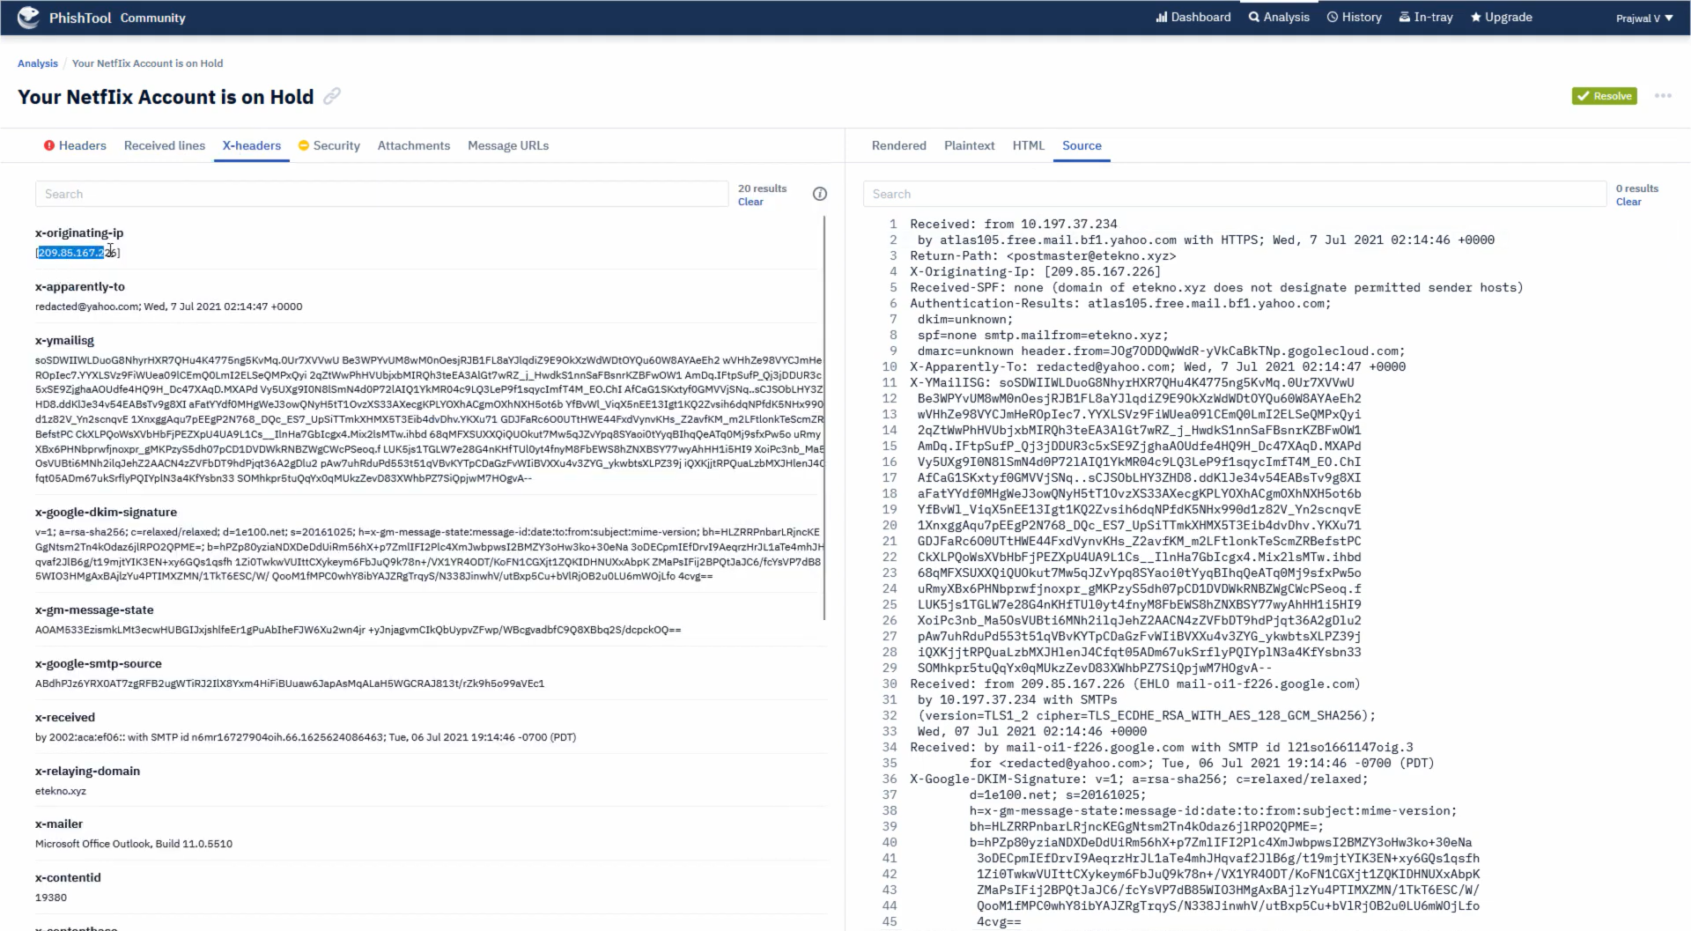

Slide 3
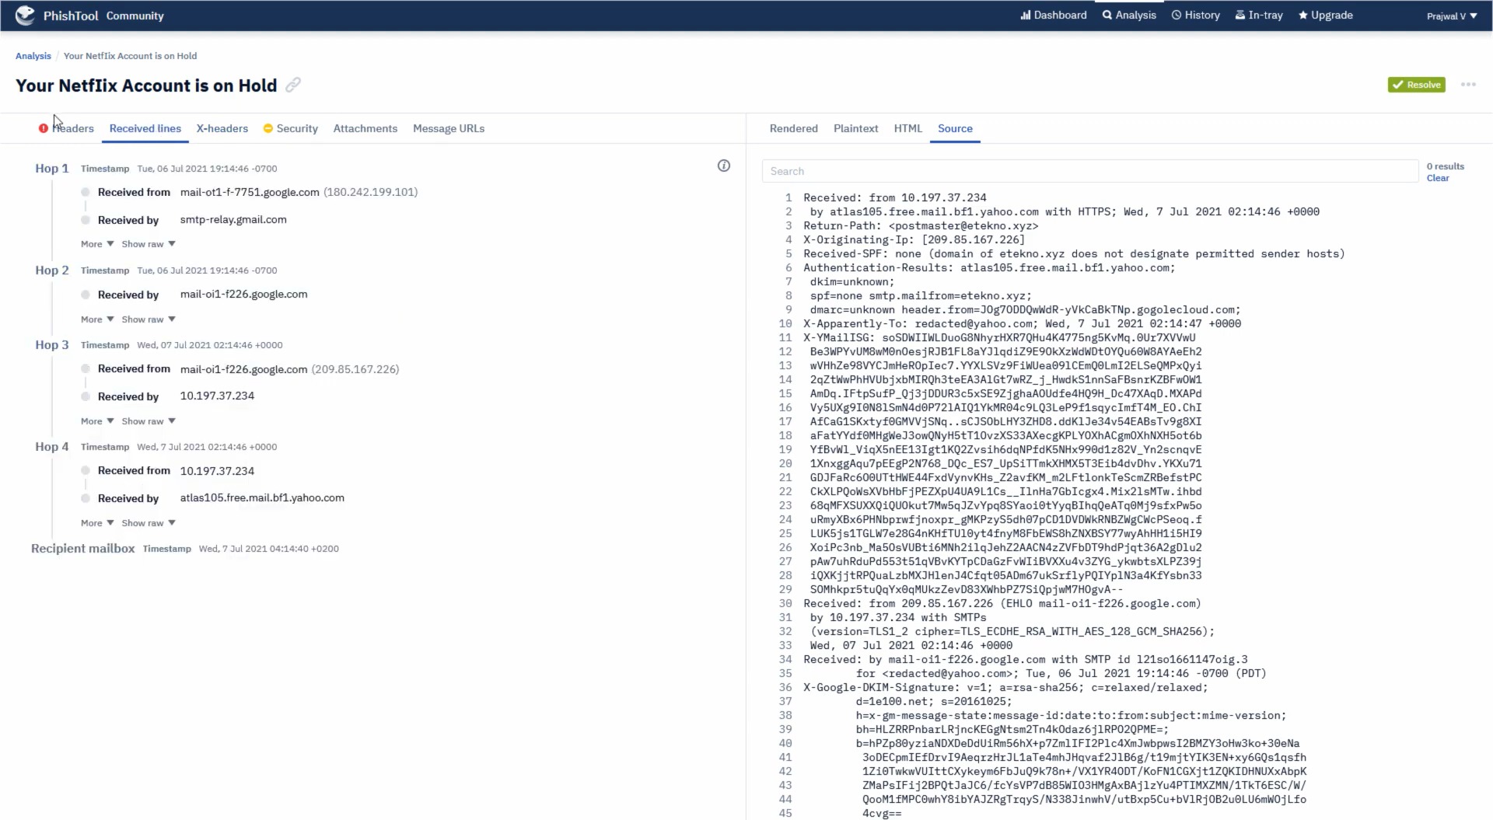

Slide 4
